Slide 1

HEALTH CARE AND VACCINE
APPOINTMENT TRACKER
GAYATHIRI.K

Slide 2

Introduction:
In modern healthcare, data is often scattered across different offices. This project creates a Centralized Source of Truth where a patient’s profile, medical history (vaccines), physical responses (symptoms), and financial records (insurance) are all linked.
​ Traditional systems often fail to connect a patient's side effects to their specific vaccine lot number or their billing status.
​ Using MySQL, we built a relational structure that uses a unique Patient _ID to bridge five critical healthcare areas, allowing for instant, complex reporting

Slide 3

TABLES USED:
1.Patient_Profile
2.Appointment_Tracker
3.Vaccine_Record
4.Symptom_Log
5.Expense_Tracker

Slide 4

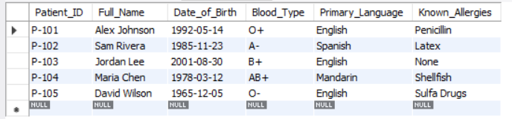
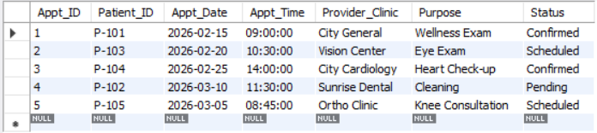
PATIENT_PROFILE
APPOINTMENT_TRACKER

Slide 5

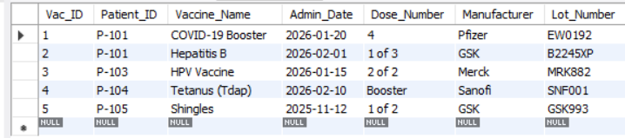
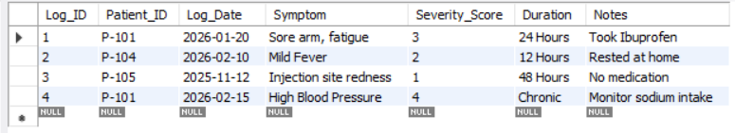
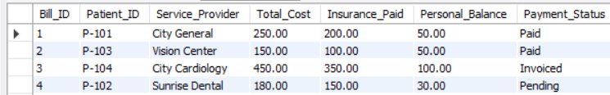
VACCINE_RECORD
SYMPTOM_LOG
EXPENSE_TRACKER

Slide 6

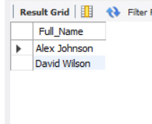
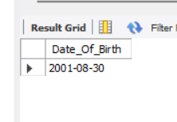
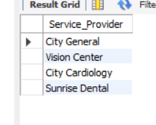
List the Full Names of all patients who have O+ or O- blood types.
select Full_Name from Patient_Profile where Blood_Type="O+" or Blood_Type="O-";
Find the Date of Birth for patient P-103.
select Date_Of_Birth from Patient_Profile where Patient_ID="P-103";
List all unique Service Providers from the Expense Tracker.
select distinct(Service_Provider) from Expense_Tracker;

Slide 7


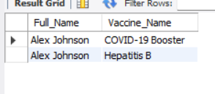
List the Vaccine Name and Admin Date for Maria Chen.
select v.Vaccine_Name,v.Admin_Date from Patient_Profile p join Vaccine_Record v onp.Patient_ID=v.Patient_IDwhere Full_Name="Maria Chen";
Does any patient with a Penicillin allergy have a vaccine recorded?
select p.Full_Name ,v.Vaccine_Name from Patient_Profile p join Vaccine_Record v on p.Patient_ID=v.Patient_ID where Known_Allergies="Penicillin";

Slide 8


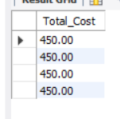
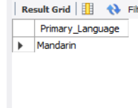
Find all appointments that are currently marked as 'Pending’.
select * from Appointment_Tracker where Status='Pending';
What was the Total Cost for the appointment at 'City Cardiology’?
select Total_Cost from Expense_Tracker where Service_Provider="City Cardiology";
Find the Emergency Contact (or Language) for the patient who had a 'Mild Fever’.
select p.Primary_Language from Patient_Profile p join Symptom_Log s onp.Patient_ID=s.Patient_IDwhere Symptom="Mild Fever";

Slide 9

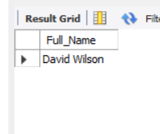
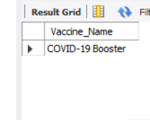
Find the Full Name of the patient who received the 'Shingles' vaccine.
select p.Full_Name from Patient_Profile p join Vaccine_Record v onp.Patient_ID=v.Patient_IDwhere Vaccine_Name="Shingles";
How many different vaccines in your table were made by Pfizer.?
select Vaccine_Name from Vaccine_Record where Manufacturer='Pfizer';

Slide 10

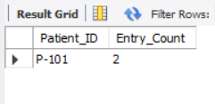
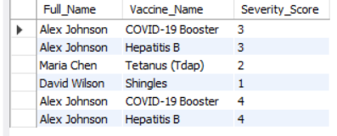

​Which Patient ID has more than one entry in the Symptom Log?
select Patient_ID,count(*) as Entry_Count from Symptom_Log group by Patient_ID having count(*)>1;
Create a report showing Name, Vaccine Name, and Severity Score for everyone who had a reaction.
select p.Full_Name,v.Vaccine_Name,s.Severity_Score from Patient_Profile p join Vaccine_Record v onp.Patient_ID=v.Patient_IDjoin Symptom_Log s onv.Patient_ID=s.Patient_ID;
Which patient (Full Name) had the lowest percentage of their bill covered by insurance?
select p.Full_Name , (e.Insurance_Paid/e.Total_Cost)*100 as Coverage_Percent from Patient_Profile p join Expense_Tracker e onP.Patient_ID=e.Patient_IDorder by Coverage_Percent Asc Limit 1;

Slide 11


Create a single row for 'Alex Johnson' that shows his Blood Type, his next Appt_Date, his most recent Vaccine_Name, his worst Symptom, and his total Personal_Balance.
select p.Full_Name, p.Blood_Type, MIN(a.Appt_Date) AS Next_Appointment, MAX(s.Severity_Score) AS Worst_Reaction,SUM(e.Personal_Balance) AS Total_Balance_Duefrom Patient_Profile p left join Appointment_Tracker a on p.Patient_ID = a.Patient_IDleft join Symptom_Log s on p.Patient_ID = s.Patient_IDleft join Expense_Tracker e onp.Patient_ID = e.Patient_IDwhere p.Full_Name = 'Alex Johnson'group by p.Full_Name, p.Blood_Type;

Slide 12

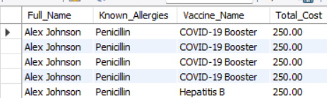
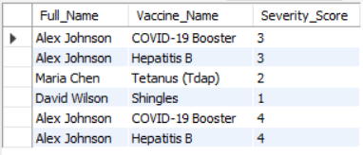
List the Full Name, Allergies, Vaccine Name, and Total Cost for any patient who had a "High Severity" reaction (Severity Score > 3).
select p.Full_Name, p.Known_Allergies, v.Vaccine_Name, e.Total_Costfrom Patient_Profile p join Vaccine_Record v on p.Patient_ID = v.Patient_IDjoin Symptom_Log s on p.Patient_ID = s.Patient_ID join Expense_Tracker e on p.Patient_ID = e.Patient_IDwhere s.Severity_Score > 3order by e.Total_Cost desc;
Create a report showing Name, Vaccine Name, and Severity Score for everyone who had a reaction.
select p.Full_Name,v.Vaccine_Name,s.Severity_Score from Patient_Profile p join Vaccine_Record v onp.Patient_ID=v.Patient_IDjoin Symptom_Log s onv.Patient_ID=s.Patient_ID;

Slide 13

CONCLUSION:
This project demonstrates the power of Relational Databases in transforming raw healthcare data into actionable insights.
The strength of this system lies not in the data it stores, but in the relationships it defines. As healthcare becomes increasingly data-driven, tools like this integrated tracker will be the foundation for safer, more efficient, and more personalized patient care.

Slide 14

Thank you !

